Slide 1


Day 4 - Predict & API
Building Credit Scoring Model
pacmann.io
© 2022 – Pacmann AI

Slide 2
Outlines
API

Slide 3
Modeling Workflow (Simplified)
Data Preparation
Load data
Model Predictions
Create a predictions
Sample selection
Split data to Train, Valid, & Test
Create & Evaluate Model
Create a classification model
Tune the model
EDA
Perform data exploration
Data Preprocessing
Preprocess the data so that can be modeled
Missing value imputation
Remove outliers

Slide 4
Predictions
Notes:
Transisi antar outline

Slide 5
Predict
Given a model & data to predict:
Preprocess the data to predict
Validate the columns
Imputation
Transformation
Predict using the model
Predict probability
Use the given threshold to predict the class

Slide 6
API
Notes:
Transisi antar outline

Slide 7
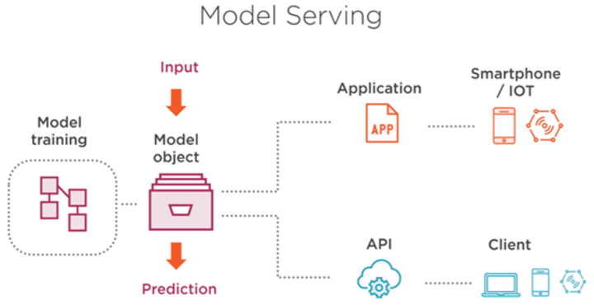
What is API?
What is it?
API (application programming interface), allows two applications to talk to each other.
Why we need it?
Usually on model serving so client can request easily with the server
Tools? FastAPI
image source

Slide 8
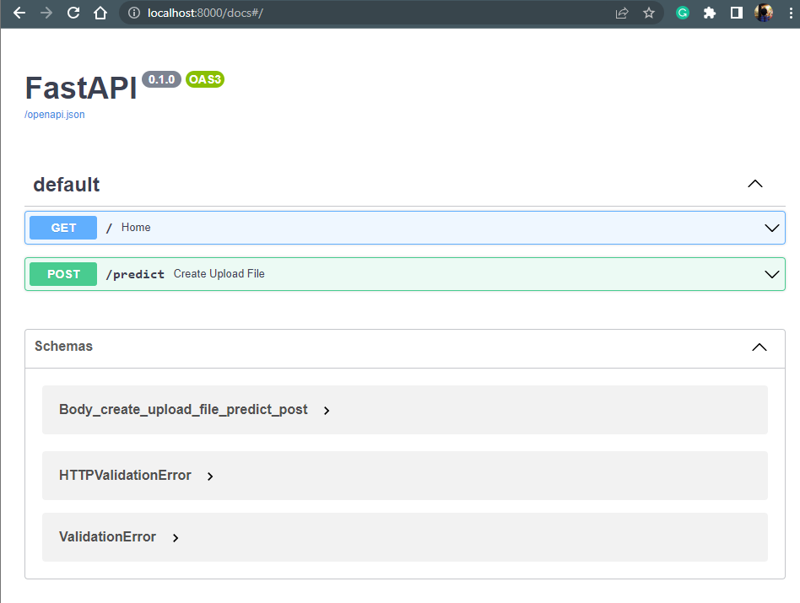
What you will see

Slide 9
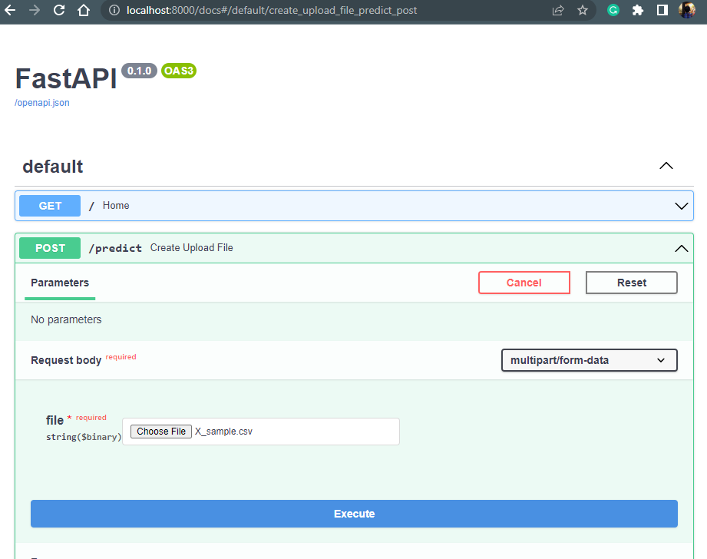
What you will see

Slide 10
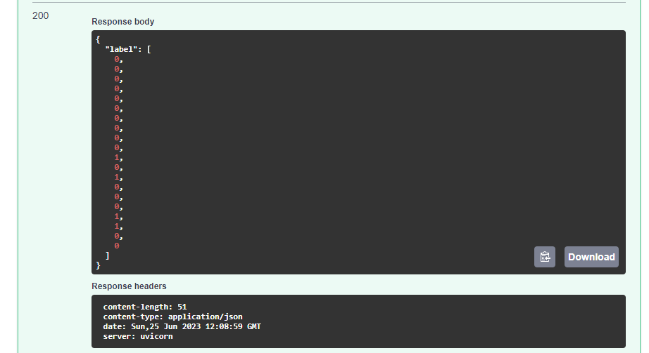
What you will see

Slide 11
Streamlit
Notes:
Transisi antar outline

Slide 12
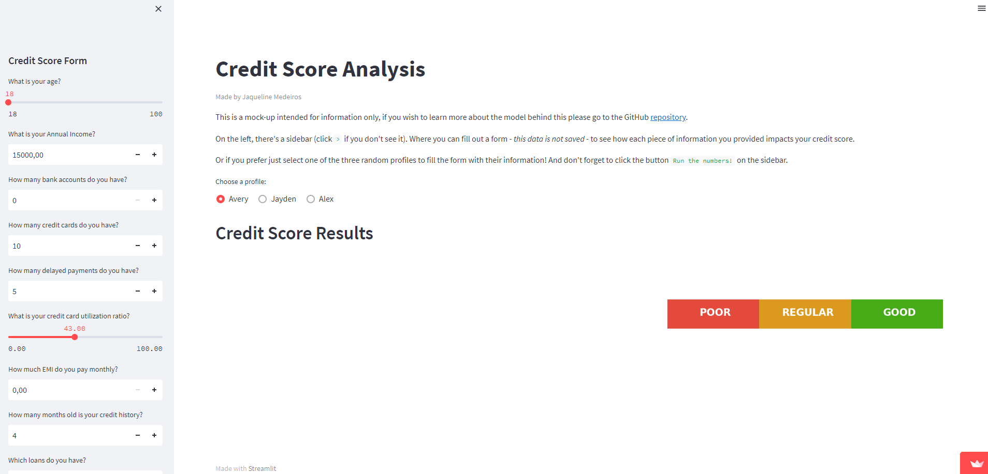
Better user interface in calling the API
Link to streamlit

Slide 13
Let’s Code!
Code references: https://github.com/amalinadhi/credit_analytics
Notes:
Transisi antar outline

Slide 14
Thank You
Notes:
Transisi antar outline

